Slide 1
Retrieval-augmented generation (RAG) by Sachin Sakpal

Slide 2
Retrieval-augmented generation (RAG)
Retrieval-augmented generation (RAG) is an AI technique that enhances the capabilities of language models by connecting them to external knowledge sources. It combines the strengths of retrieval-based and generative-based AI models to provide more accurate, relevant, and context-aware responses. RAG allows language models to access and utilize information beyond their training data, such as internal knowledge bases or specialized datasets, without the need for constant retraining.
RAG is a hybrid AI architecture that combines two core components:
Retriever: Fetches relevant documents or information from an external knowledge base.
Generator: Uses a language model (like GPT) to generate human-like answers using both the query and retrieved content.

Slide 3
🧠 Core Components of RAG RAG consists of two major modules:
1. Retriever
Purpose: Finds relevant documents or data based on the input query.
Input: User query
Output: Top-k relevant documents or passages
Works using embedding-based search (dense vectors) in a vector database like FAISS, Pinecone, Weaviate, etc.
2. Generator
Purpose: Generates natural language answers using the retrieved documents + the original query.
Input: [retrieved_docs + query]
Output: Human-readable response
Uses a pretrained language model (e.g., BART, T5, GPT) for generation.

Slide 4
Why Use RAG ?
Traditional LLM | RAG-enhanced LLM
Limited to training data | Can access up-to-date or domain-specific knowledge
Hallucination-prone | More grounded in factual sources
Static knowledge | Dynamic knowledge from databases or documents

Slide 5
Used in
Industry | Use Case
Legal | Case law retrieval + answer generation
Healthcare | Medical diagnosis + literature-based evidence
Enterprise | Chatbots grounded in internal documentation
Finance | Answering questions from annual reports or filings

Slide 6
🛠 Tools to Build RAG Systems
LangChain / LlamaIndex – High-level RAG orchestration
FAISS, Chroma, Weaviate, Pinecone – Vector DBs
OpenAI, Cohere, HuggingFace, Google Vertex AI – Embedding & LLM APIs
Tool | Purpose
Hugging Face Transformers | Ready-made RAG models
LangChain | Build end-to-end RAG pipelines
FAISS | Fast similarity search for dense vectors
Pinecone / Weaviate | Managed vector DBs for retrieval
OpenAI Embeddings | For dense retriever construction

Slide 7
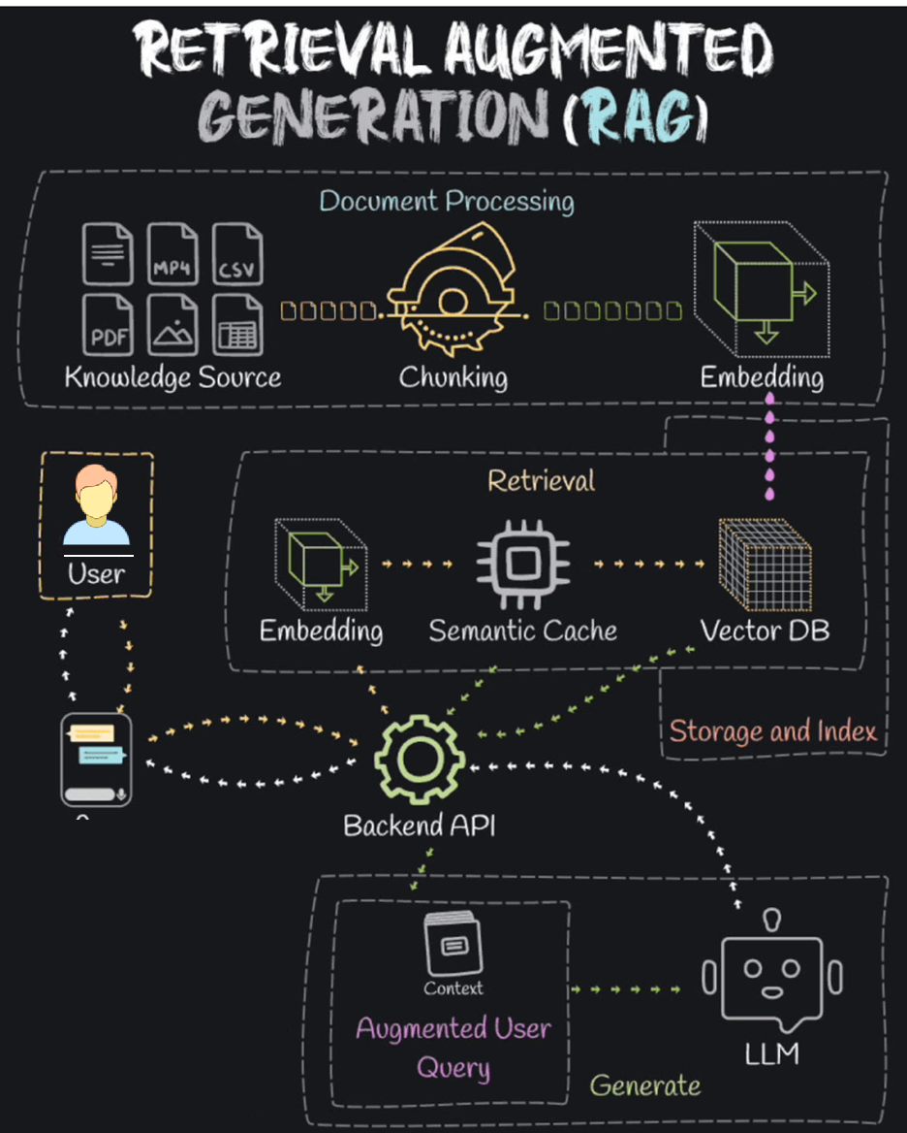
rag architecture Model

Slide 8
RAG vs MCP
Aspect | RAG | MCP
Data access | Manual retrieval via your code | Defined schema for files/tools
Who retrieves? | Your app / retriever logic | OpenAI platform does context routing
Real-time search? | Yes, often using vector search | No, more structured static input
Developer role | Needs to build retriever, chunker, embedder | Needs to implement the context schema
Use in ChatGPT | Via tools like “Ask your docs” | Used behind the scenes in Advanced Data Analysis, file chat

Slide 9
✅ Benefits of RAG ❌ Challenges of RAG
✅ Access up-to-date info (no retraining needed)
✅ Handles proprietary or private documents
✅ Reduces hallucination by grounding responses
✅ Scales with new data by updating vector DB only
⚠️ Chunk size tuning (too big = loss of relevance, too small = missing context)
⚠️ Vector search quality
⚠️ Prompt size limits (token limits)

Slide 10
Step-by-Step Example: RAG with Your Own PDF
We'll use:
PyMuPDF (fitz) to extract PDF text
Hugging Face Transformers for embeddings & generation
FAISS to store and retrieve vectors
OpenAI or Hugging Face models for answer generation

Slide 11
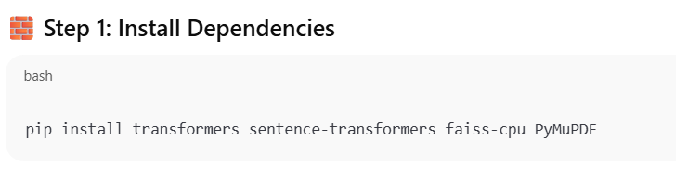
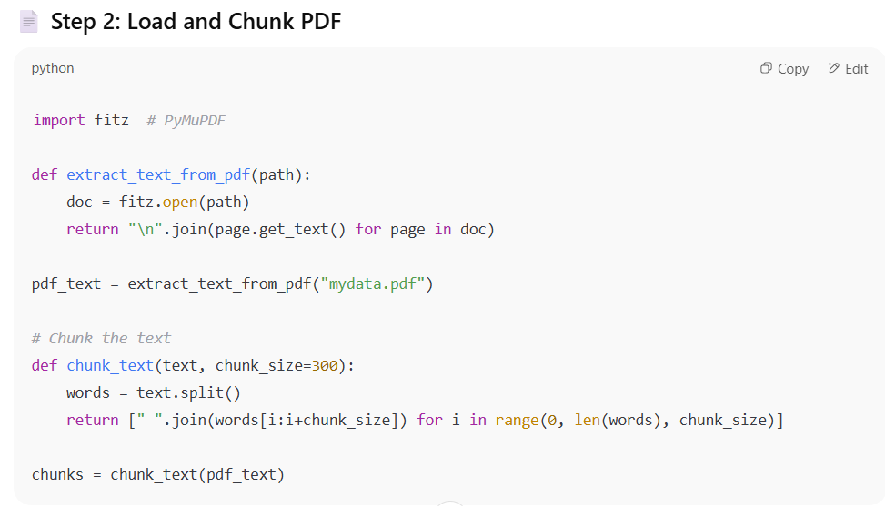

Slide 12
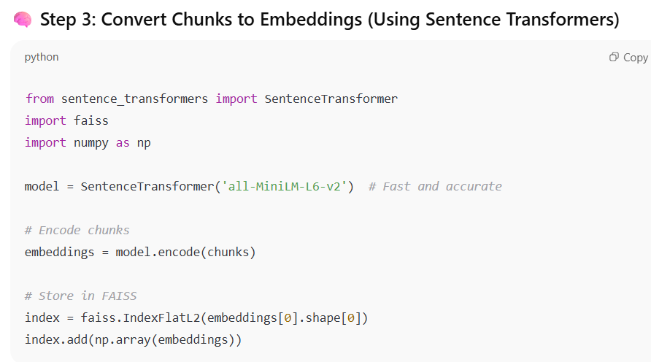
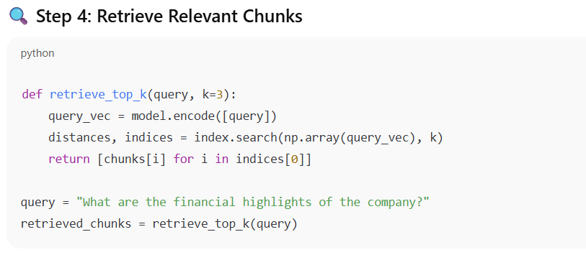

Slide 13
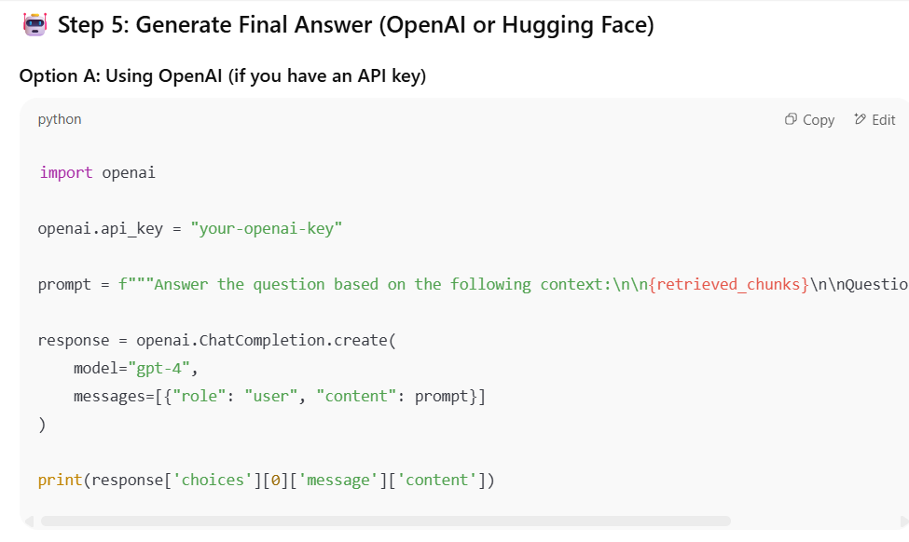

Slide 14
